Slide 1
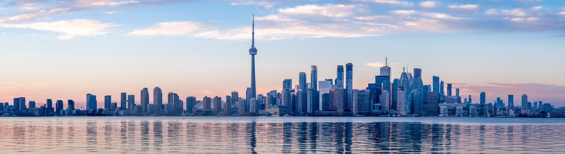
Title of my Presentation
Author(s) Name
Date of Presentation

Slide 2
Template Guidelines
Template has 1 colour scheme for general slides
Green bullets with green footer
Don’t change the logo placement or the footer
Don’t add page numbers – not required for small sequential presentations
Slide header
Font is Calibri (headings) + bold – default size is 40 pts
Shrink font size to fit longer titles (lowest is 28 pts)
Default colour is grey, can change to green (see colour codes below)
Text
Font size is 28 (recommended lowest size for presentations is 18 pts)
Grey colour is HEX #595959
Green colour is HEX #4A6036
Single space
6 pt space before line

Slide 3
Sample with Green Title
Bullets are green

Slide 4
Sample with two columns

Slide 5
Section Divider Title
Section subtitle

Slide 6
Blank slide for large graphic / illustrations – delete title for full screen

